Slide 1
Telecom Customer Churn Analysis for Telecom Industry
Predicting Customer Churn Using Machine Learning and Business Analytics
Presented By
Mahalingam R

Slide 2
Objective Predict customer churn and provide actionable business recommendations to improve customer retention.
Business Problem :
Customers leaving telecom services
Revenue loss
High customer acquisition cost
Need for predictive analytics

Slide 3
Project Workflow
Dataset Data Cleaning EDA SQL Analysis
SHAP Explainability Machine Learning Feature Engineering
Customer Segmentation Power BI Dashboard Business Recommendations

Slide 4
Tools & Technologies
Programming :
Python
SQL
Visualization :
Power BI
SHAP
Scikit-learn
Pandas
NumPy

Slide 5
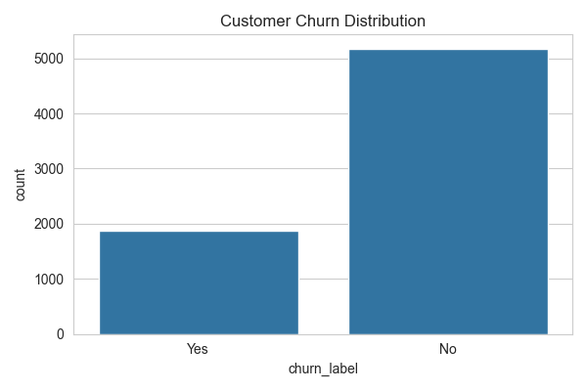
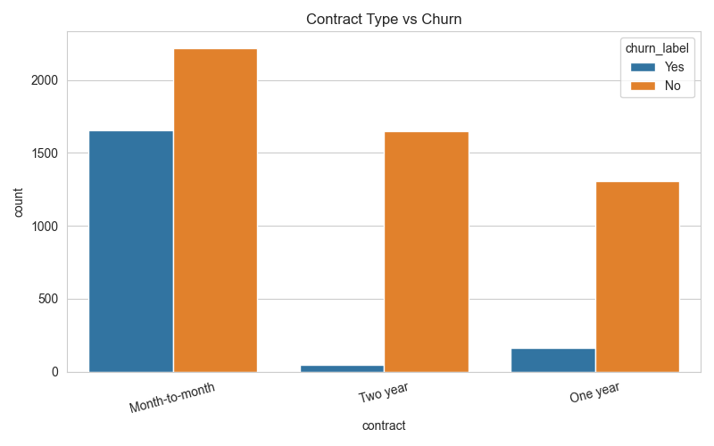
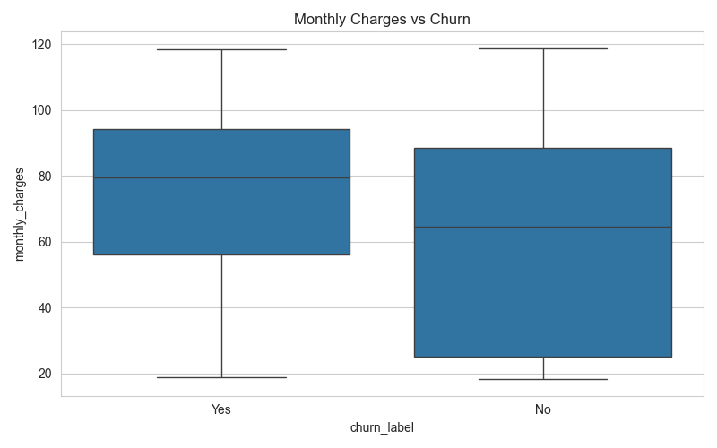
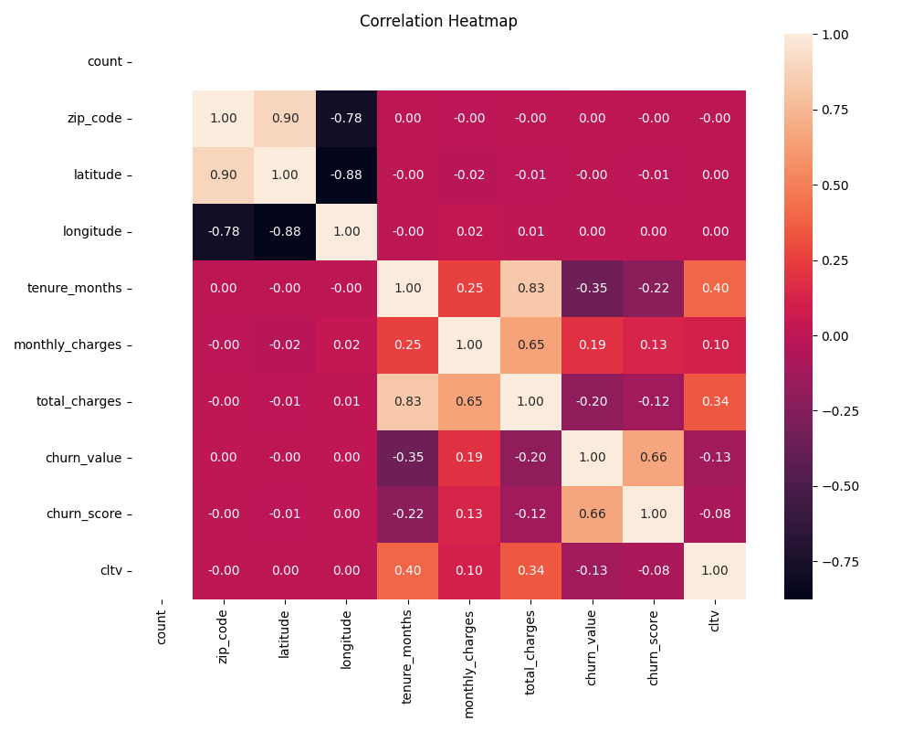
Data Preprocessing
Completed Tasks :
Removed missing values
Data type conversion
Feature encoding
Feature engineering
Dataset preparation
churn_distribution.png
contract_vs_churn.png
monthly_charges_churn.png
correlation_heatmap.png

Slide 6
Machine Learning Models
Model
Accuracy
Logistic Regression
Decision Tree
Random Forest
80.27%
75.16%
79.99%

Slide 7
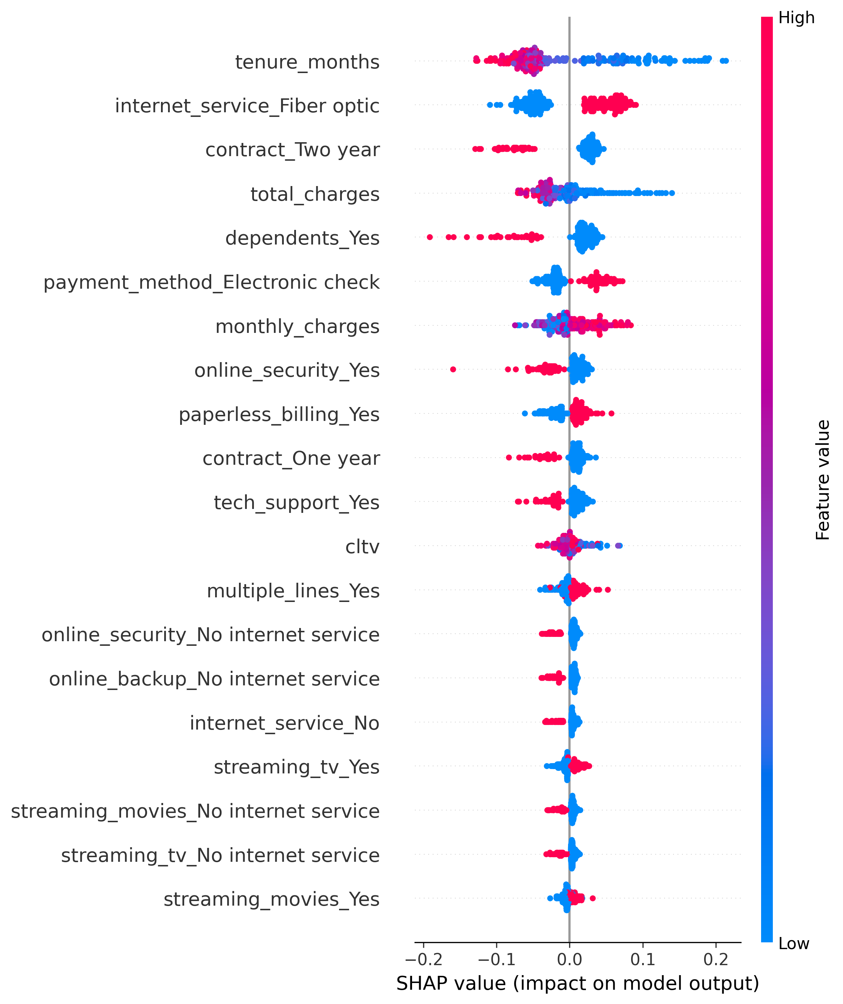
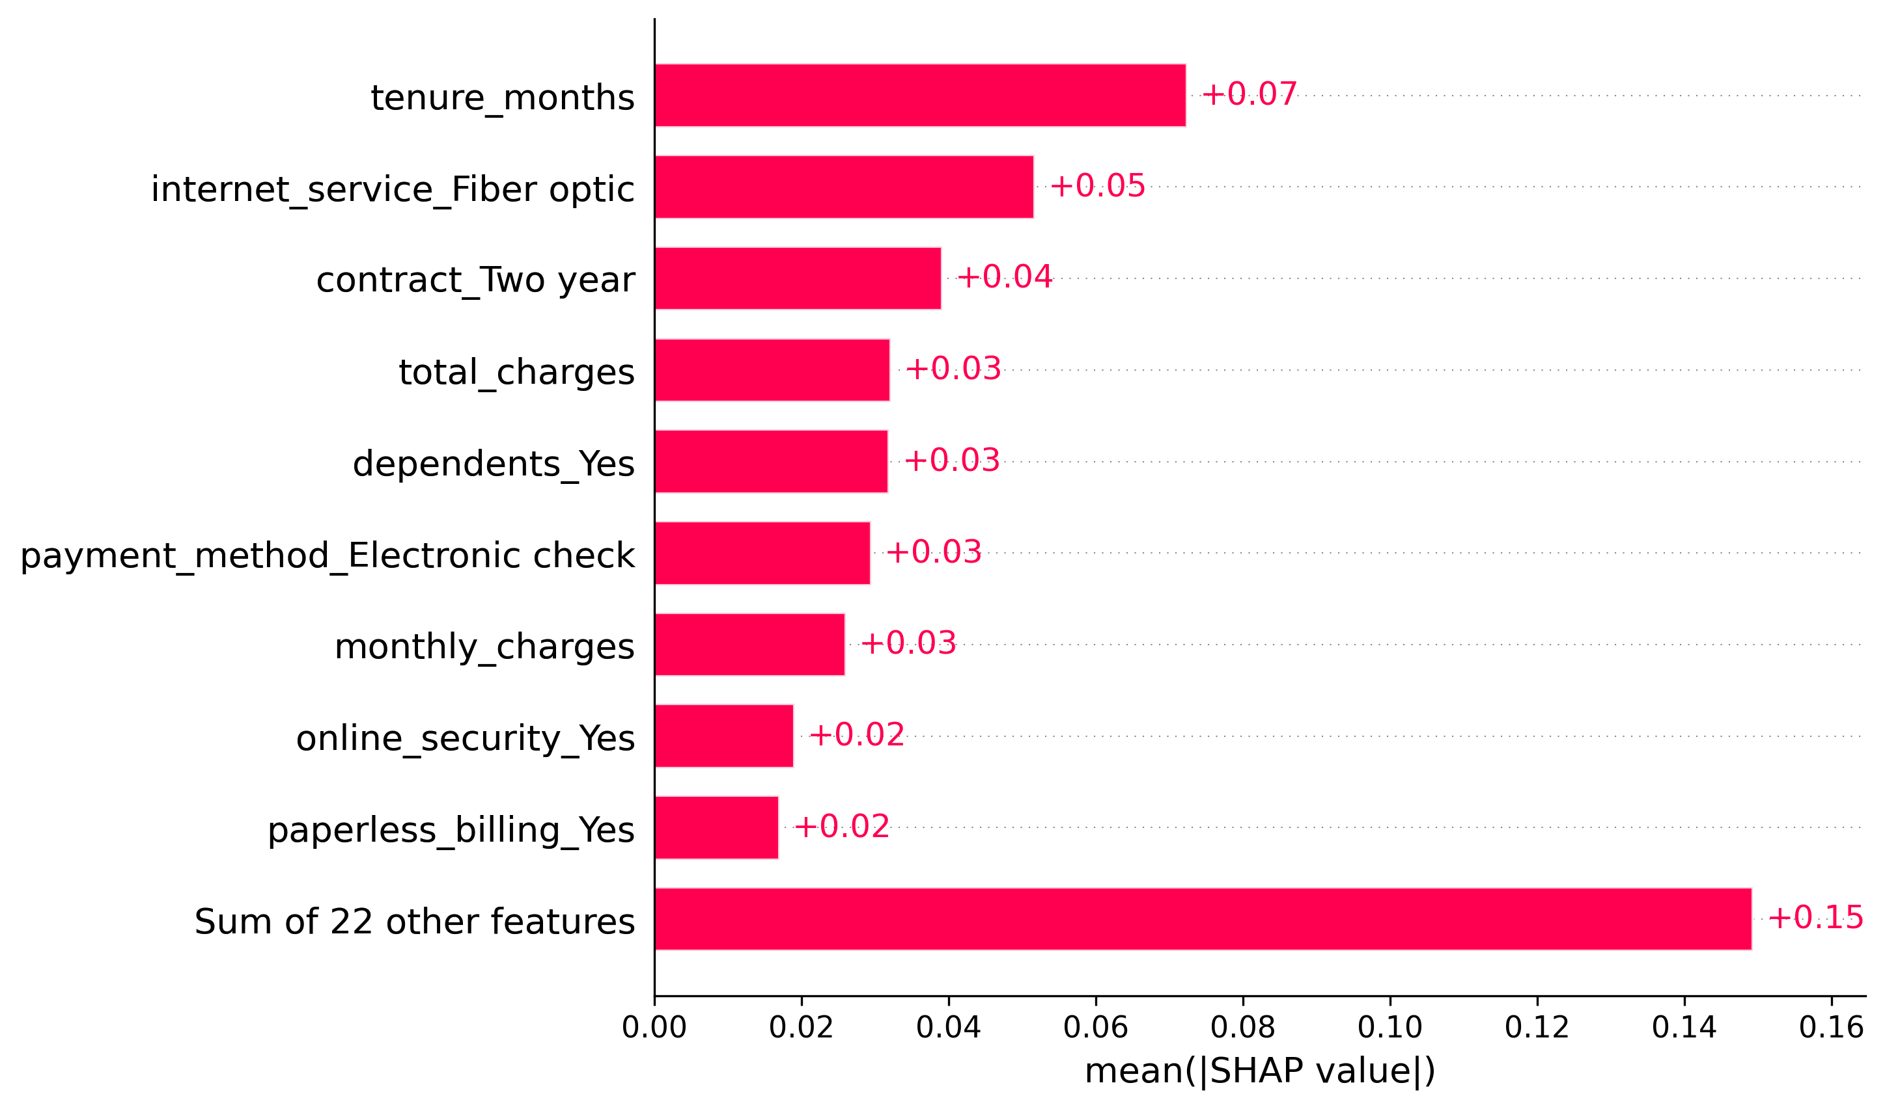
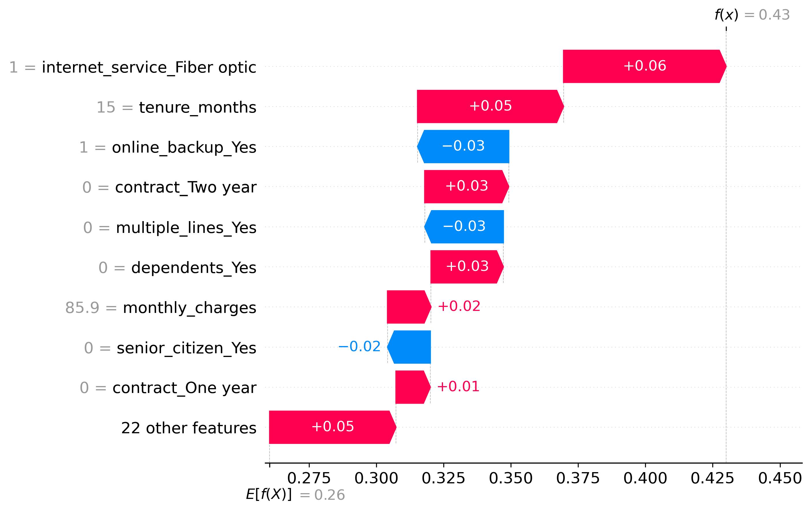
Model Explainability (SHAP)
Used SHAP to explain machine learning predictions.
Identified the top features affecting customer churn.
SHAP Summary Plot shows the overall feature impact.
Waterfall Plot explains individual customer predictions.
Improved model transparency and business understanding.
SHAP Summary Plot
SHAP Feature Importance Plot
SHAP Waterfall Plot

Slide 8
Customer Segmentation
Segment
Purpose
High Value
Loyal
At Risk
Regular
New Customer
Premium customers
Long-term customers
High churn probability
Average customers
Recently joined

Slide 9
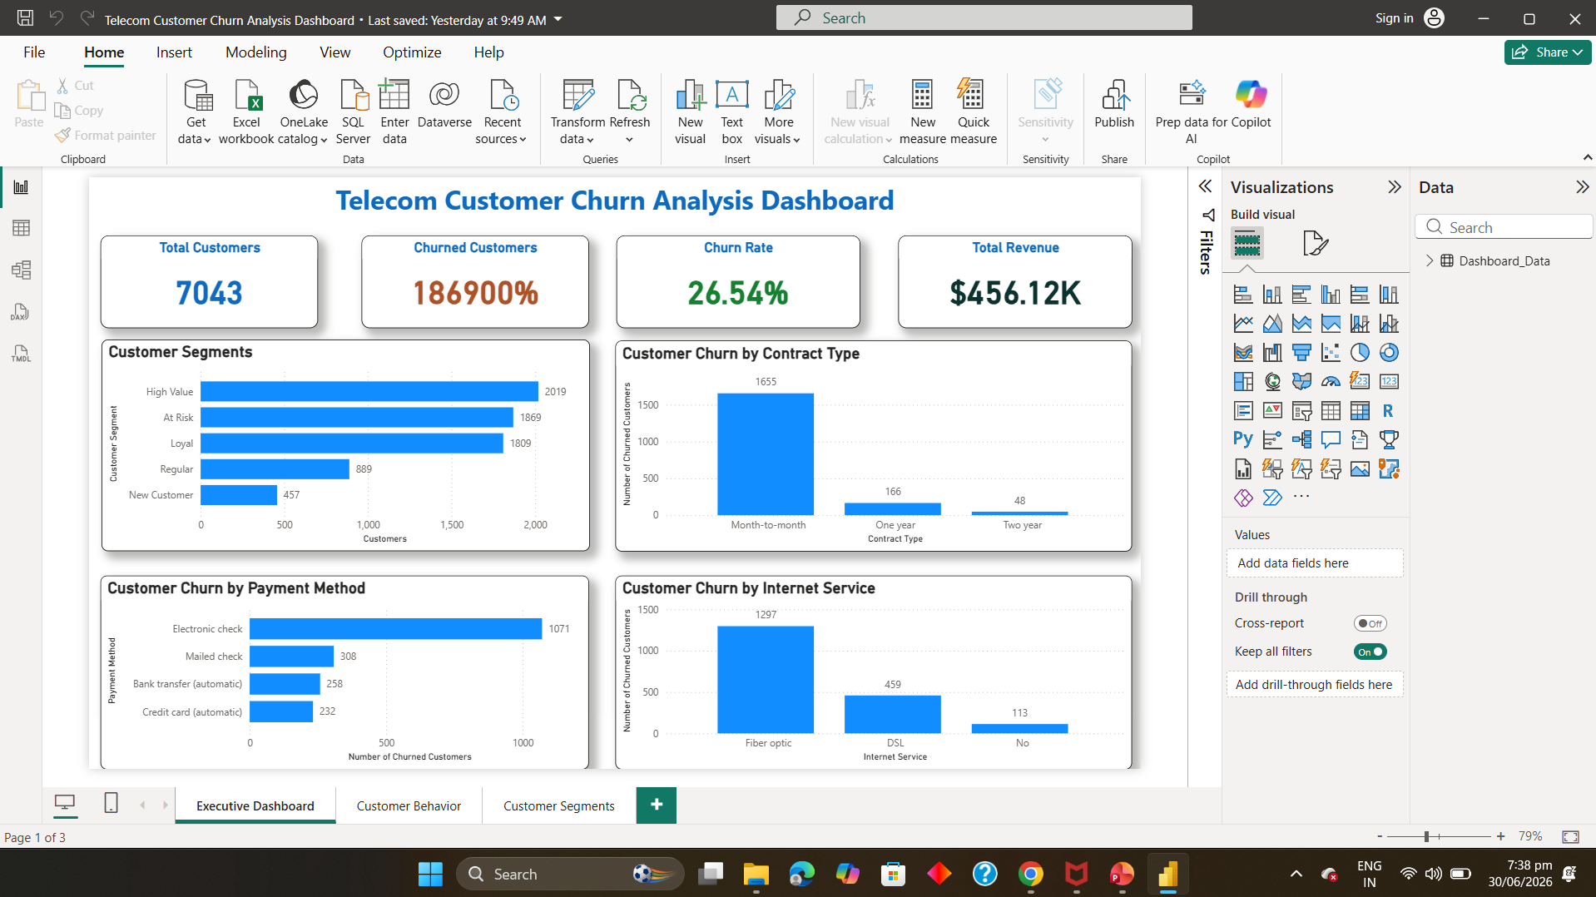
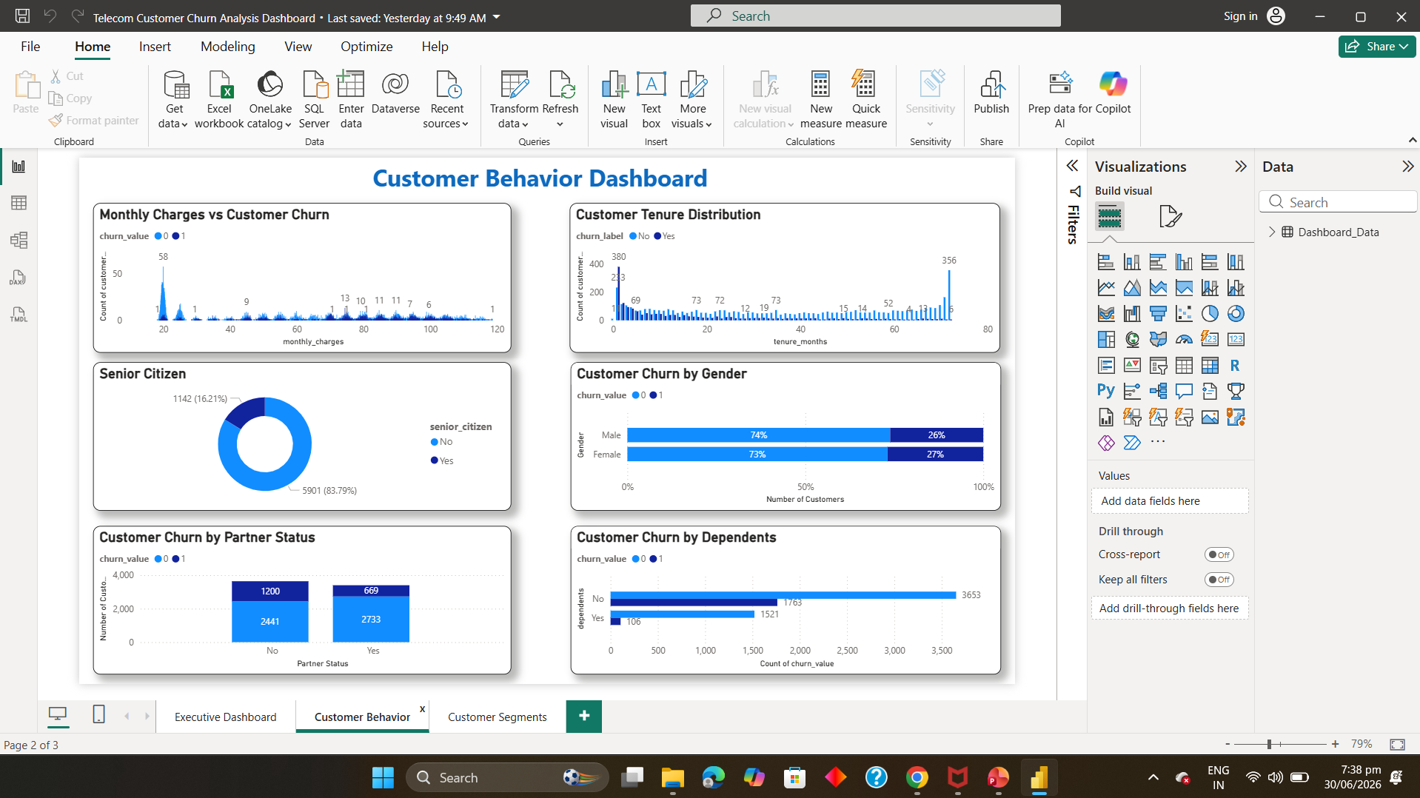
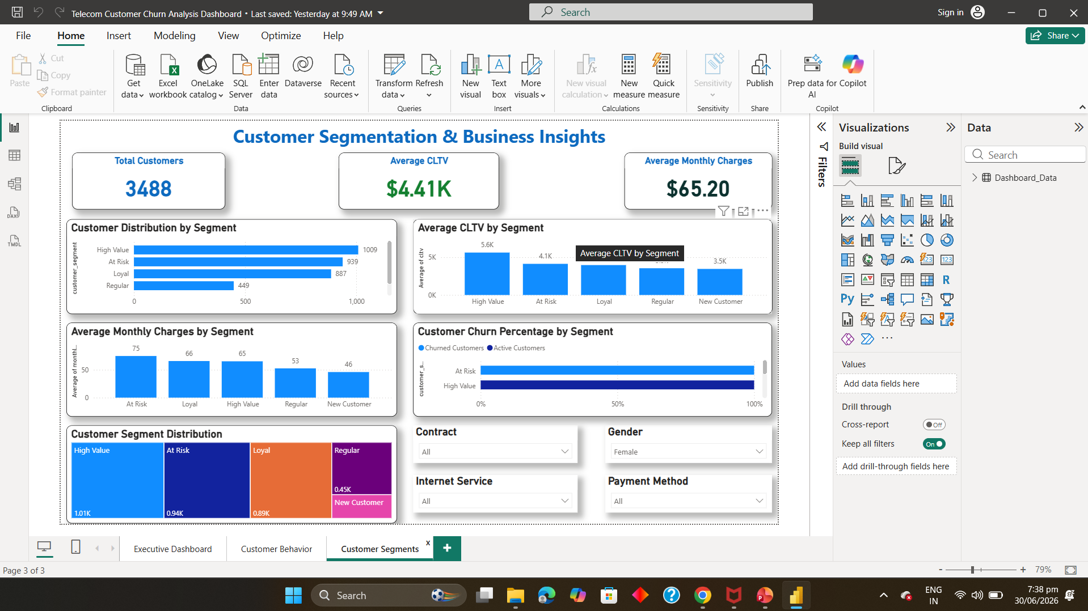
Power BI Dashboard
Executive Dashboard
Customer Behaviour Dashboard
Customer Segmentation Dashboard

Slide 10
Business Insights
📉 Contract Type :
Month-to-Month customers have the highest churn.
💳 Payment Method :
Electronic Check users are more likely to churn.
🌐 Internet Service :
Fiber Optic customers show higher churn rates.
💰 Monthly Charges :
High monthly charges increase churn risk.
⏳ Tenure :
Customer segmentation helps target retention strategies.

Slide 11
Recommendations
Business Recommendations
Future Enhancements
Offer loyalty rewards
Encourage long-term contracts
Improve customer support
Target high-risk customers
Reduce service complaints
Customer Risk Score
Real-time prediction
Streamlit web application
Cloud deployment
Automated reporting

Slide 12
Conclusion
Project Summary :
Successfully predicted telecom customer churn.
Built an end-to-end analytics solution.
Combined SQL, Python, Machine Learning, SHAP, and Power BI.
Generated actionable business insights.
Demonstrated practical business analytics skills.

Slide 13
Thank You

